Slide 1
Eclipse Memory Analyzer tool(MAT ) and VisualVM for detecting memory leaks
Presentation by:
Mehak Agarwal
Trupti Mhaisdhune

Slide 2
Outline
Introduction
Overview of Tools
How tools works (demo)
Comparison of tools
Strength and Weakness of tools
Conclusion

Slide 3
Introduction
Heap memory in java
Memory created on virtual machine to which all class instances and array are allocated.
Heap also called as run time data area
Memory leak
When some object is not used by application any more but still remains in heap memory.
Effects of memory leak
Performance issue for large memory set
High chances of system crash or application crash
Tools used to analyze heap memory
Memory analyzer, VisualVM, JProfiler, GC Viewer, JRockit, etc.

Slide 4
Overview of Memory Analyzer(MAT)
Java heap analyzer helps to find memory leaks and reduce memory consumption
Lists biggest objects
Runs leak suspect report
Helps in analyzing Java Collection usage
Analysis of Threads

Slide 5
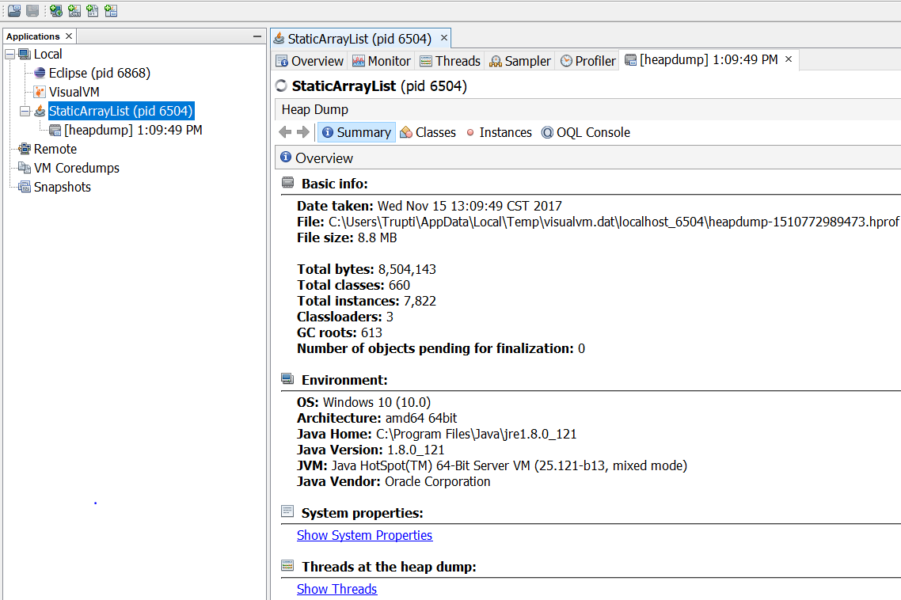
Overview of VisualVM
VisualVM Provides a graphical interface for monitoring memory usage
Creating and analyzing heap dump
Profiling an application
Connecting to remote host

Slide 6
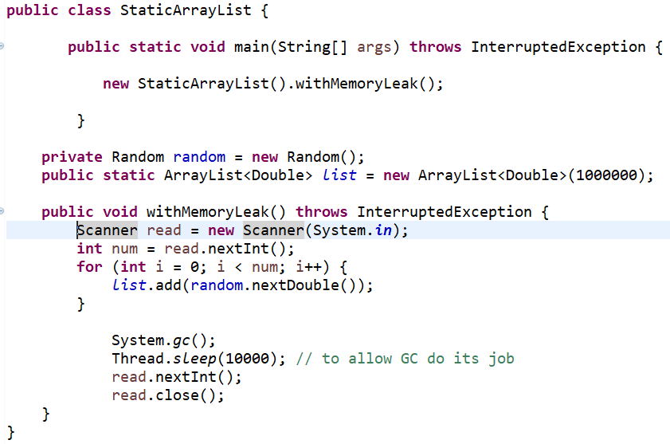
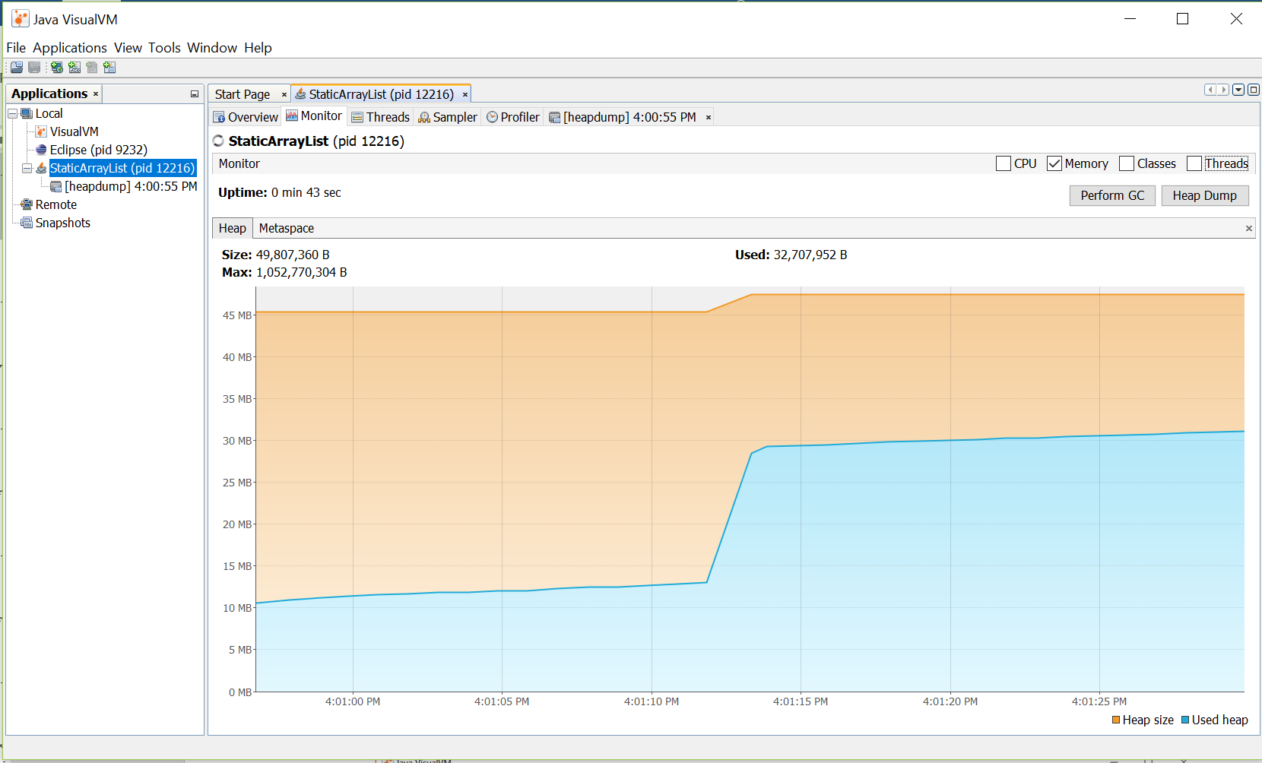
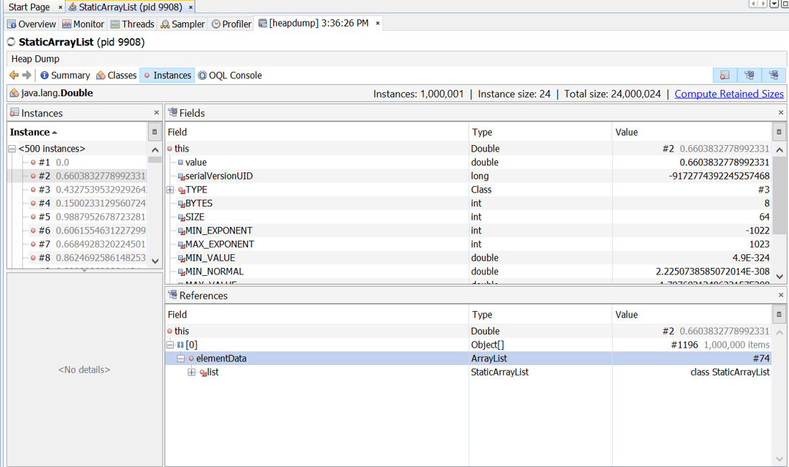
Demo Example 1

Slide 7
Comparison between Memory analyzer and VisualVM
Both tools provides the visual interaction to analyze the heap dump generated from running application.
Both tools provide important information like total heap size, used size, number of classes and their instances, biggest object etc. to analyze the memory usage.
Eclipse MAT has special functions for collections analysis like fill ratio, hash code collision ratio, soft reference statistics.
VisualVM enables us to monitor the heap memory usage at runtime.
Garbage collection activity can be performed from the VisualVM interface.

Slide 8
Strengths
Helps developers to find out memory leaks and prevent system or application crash
Eclipse Memory Analyzer:
Give high level understanding as well as summary report of memory usage
VisualVM:
Runtime monitoring of memory as well as CPU usage

Slide 9
Weakness
Does not show a exact cause, possible solutions for memory leak
Developer need to be familiar with code

Slide 10
Conclusion
Both tools calculate the retained sizes of objects, see who is preventing the Garbage Collector from collecting objects, and allows developer to find the suspect leak from programs with hundreds and millions of object.

Slide 11
Questions?

Slide 12
Thank you!

